Slide 1
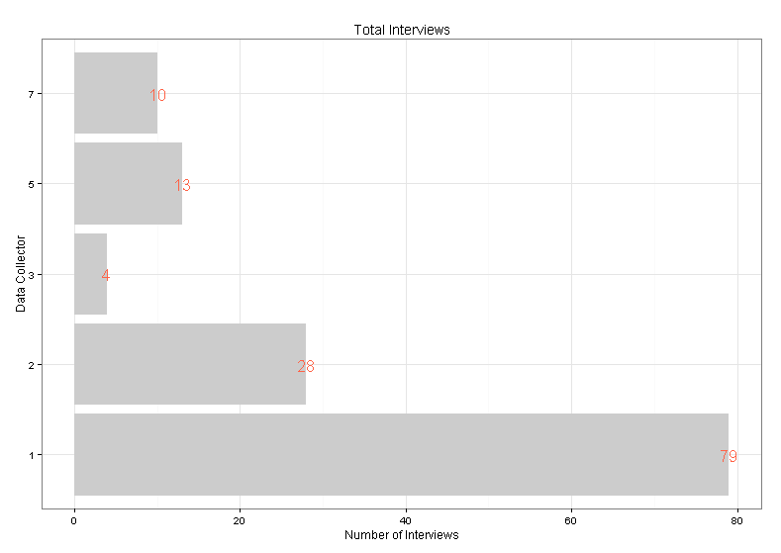
Example Report (Project Aggregate)

Slide 2
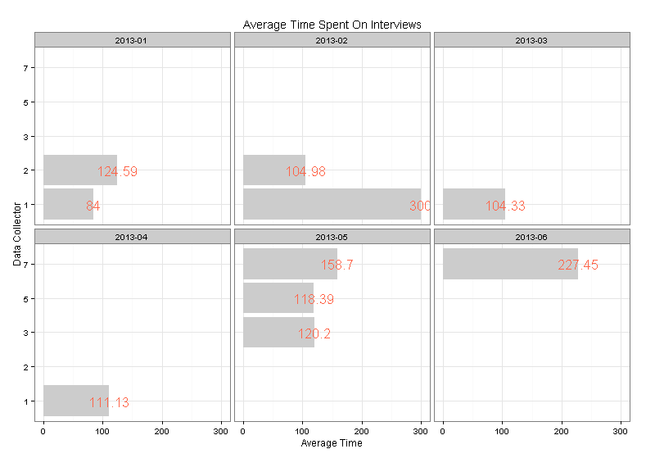
Example Report (6 Month History)

Slide 3
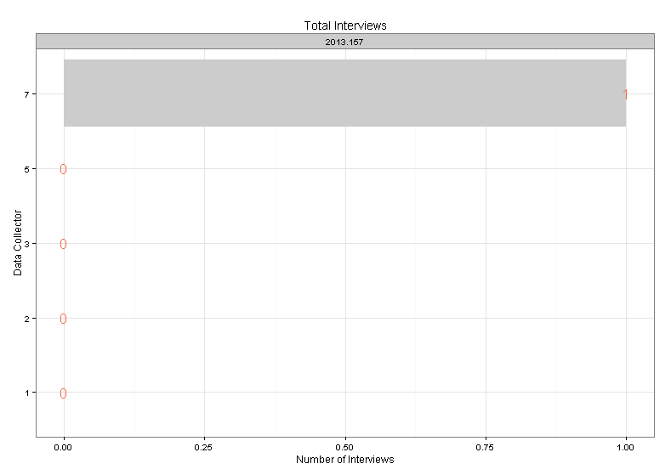
Example Report (7 Day History)

Slide 4
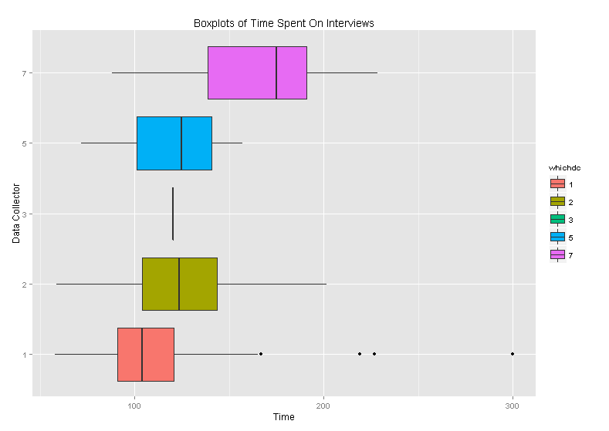
Example Report (Project Aggregate)

Slide 5
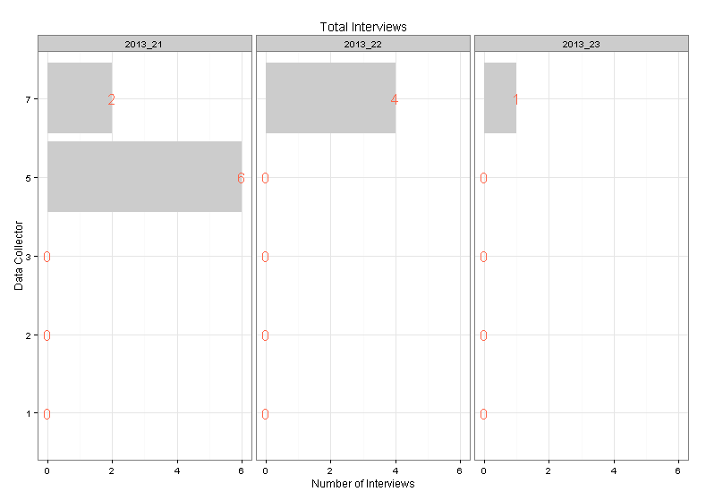
Example Report (4 Week History)

Slide 6
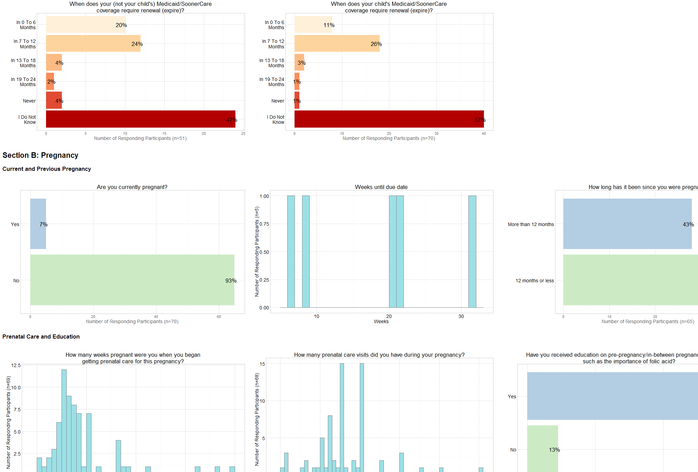
Quick for Internal Audiences

Slide 7
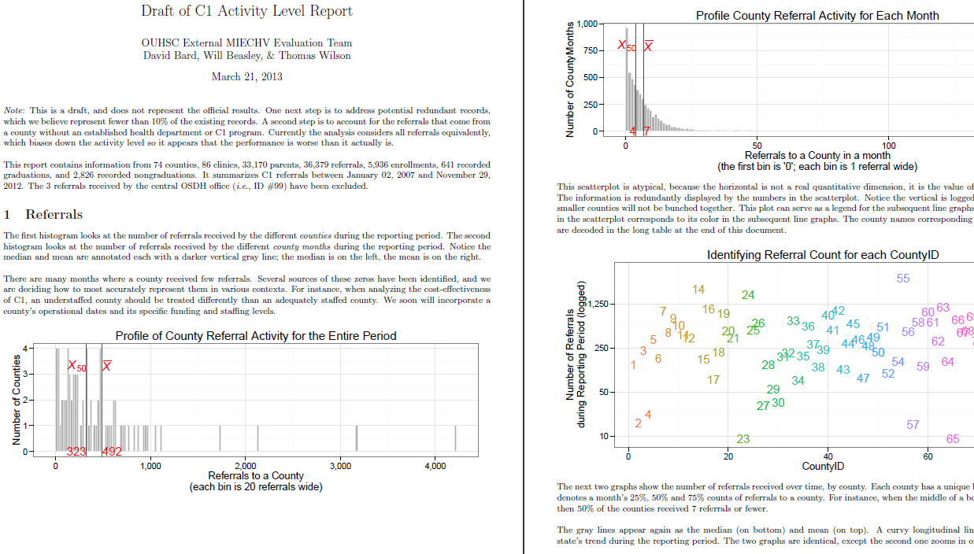
Text and Graphs for External Audiences

Slide 8
Text and Graphs for External Audiences

Slide 9
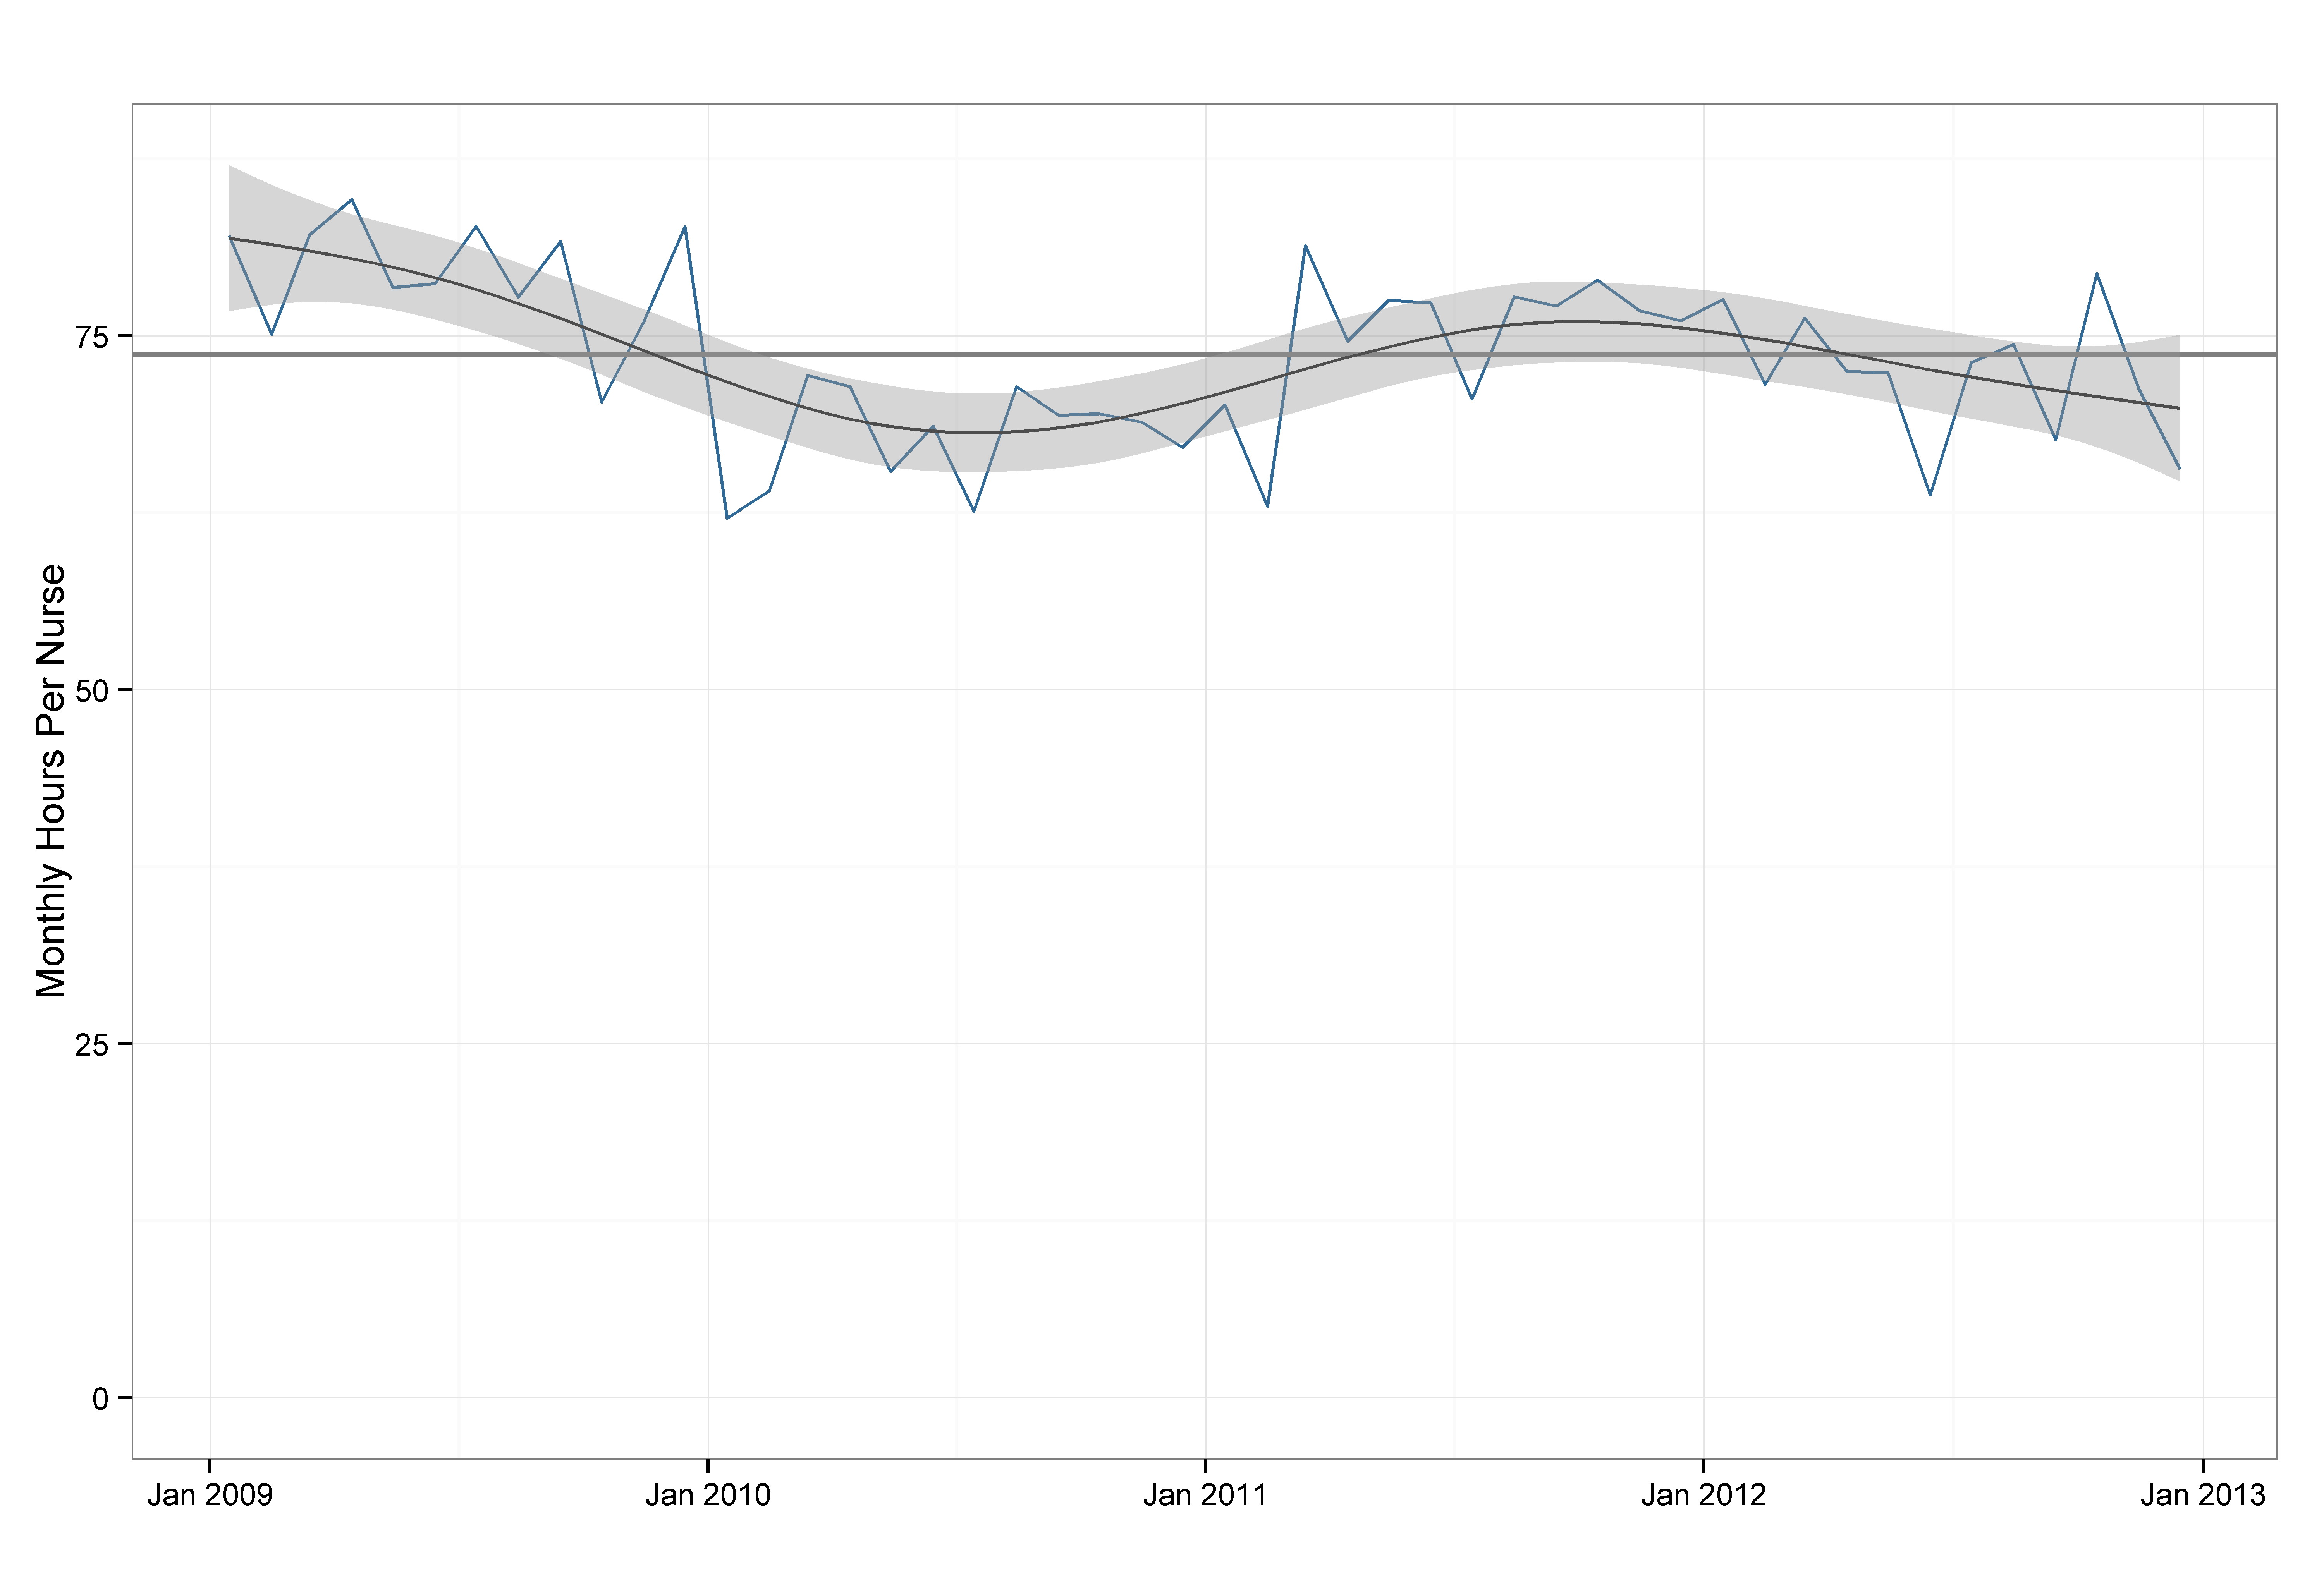
Text and Graphs for External Audiences

Slide 10
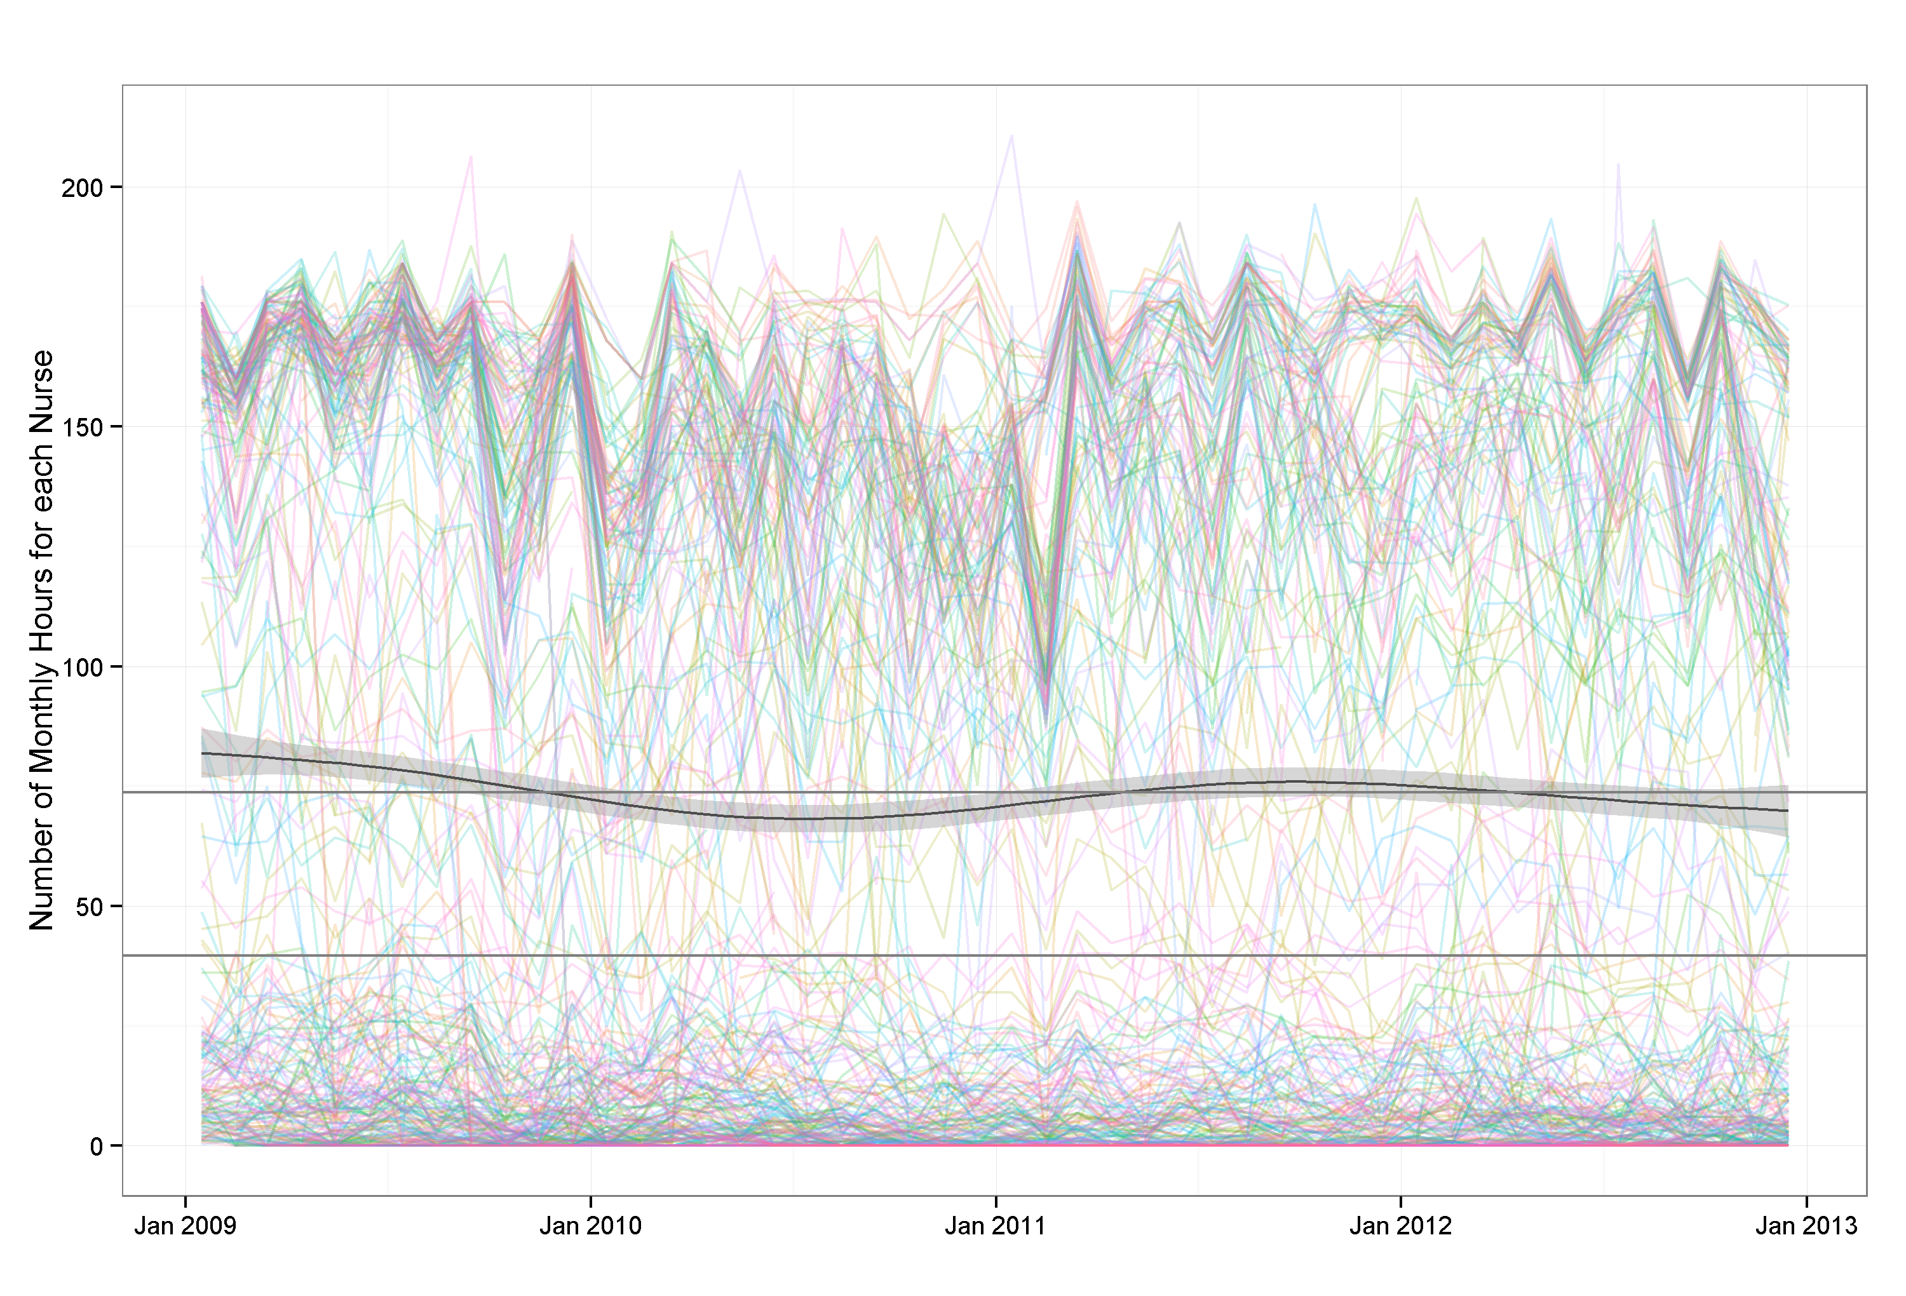
Text and Graphs for External Audiences

Slide 11
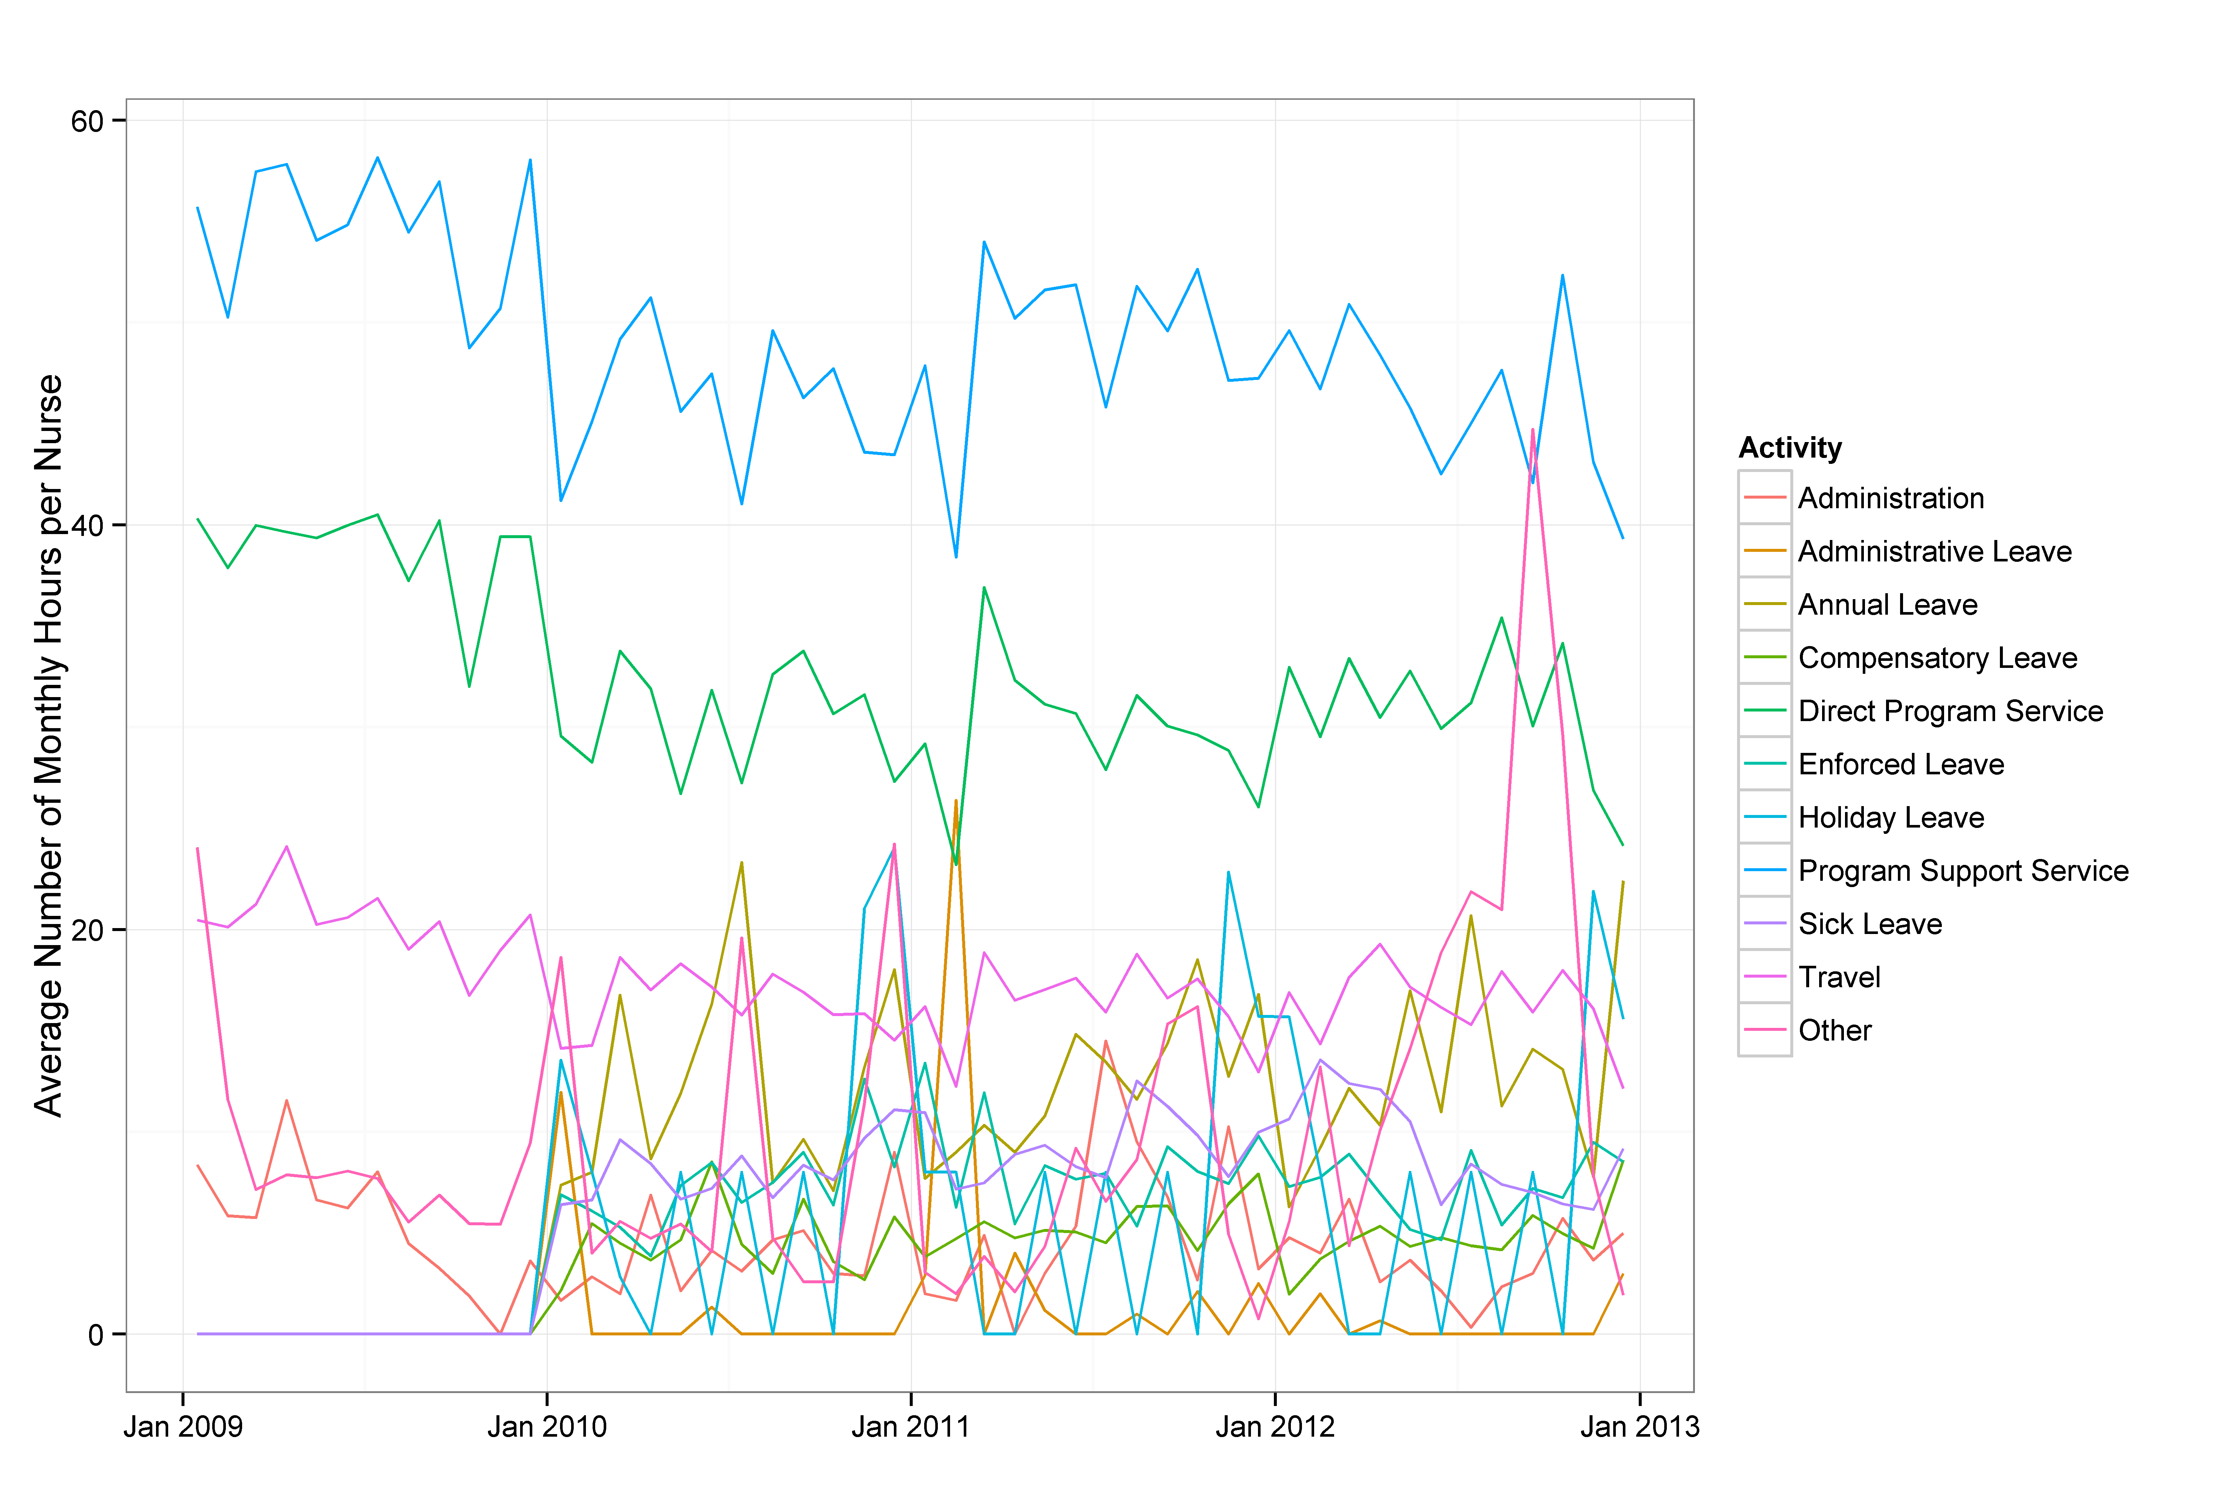
Text and Graphs for External Audiences

